Slide 1
2017-5-31
Server

Slide 2
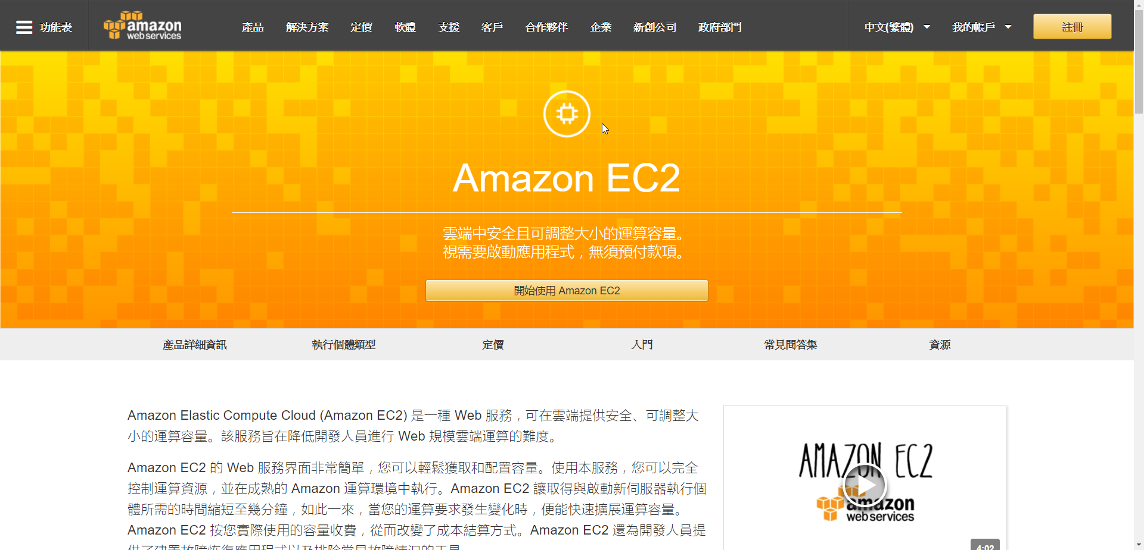
Amazon EC2

Slide 3
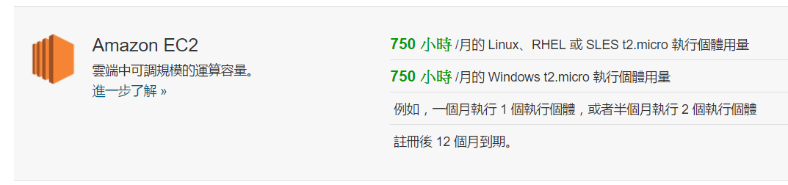
EC2 Pricing

Slide 4
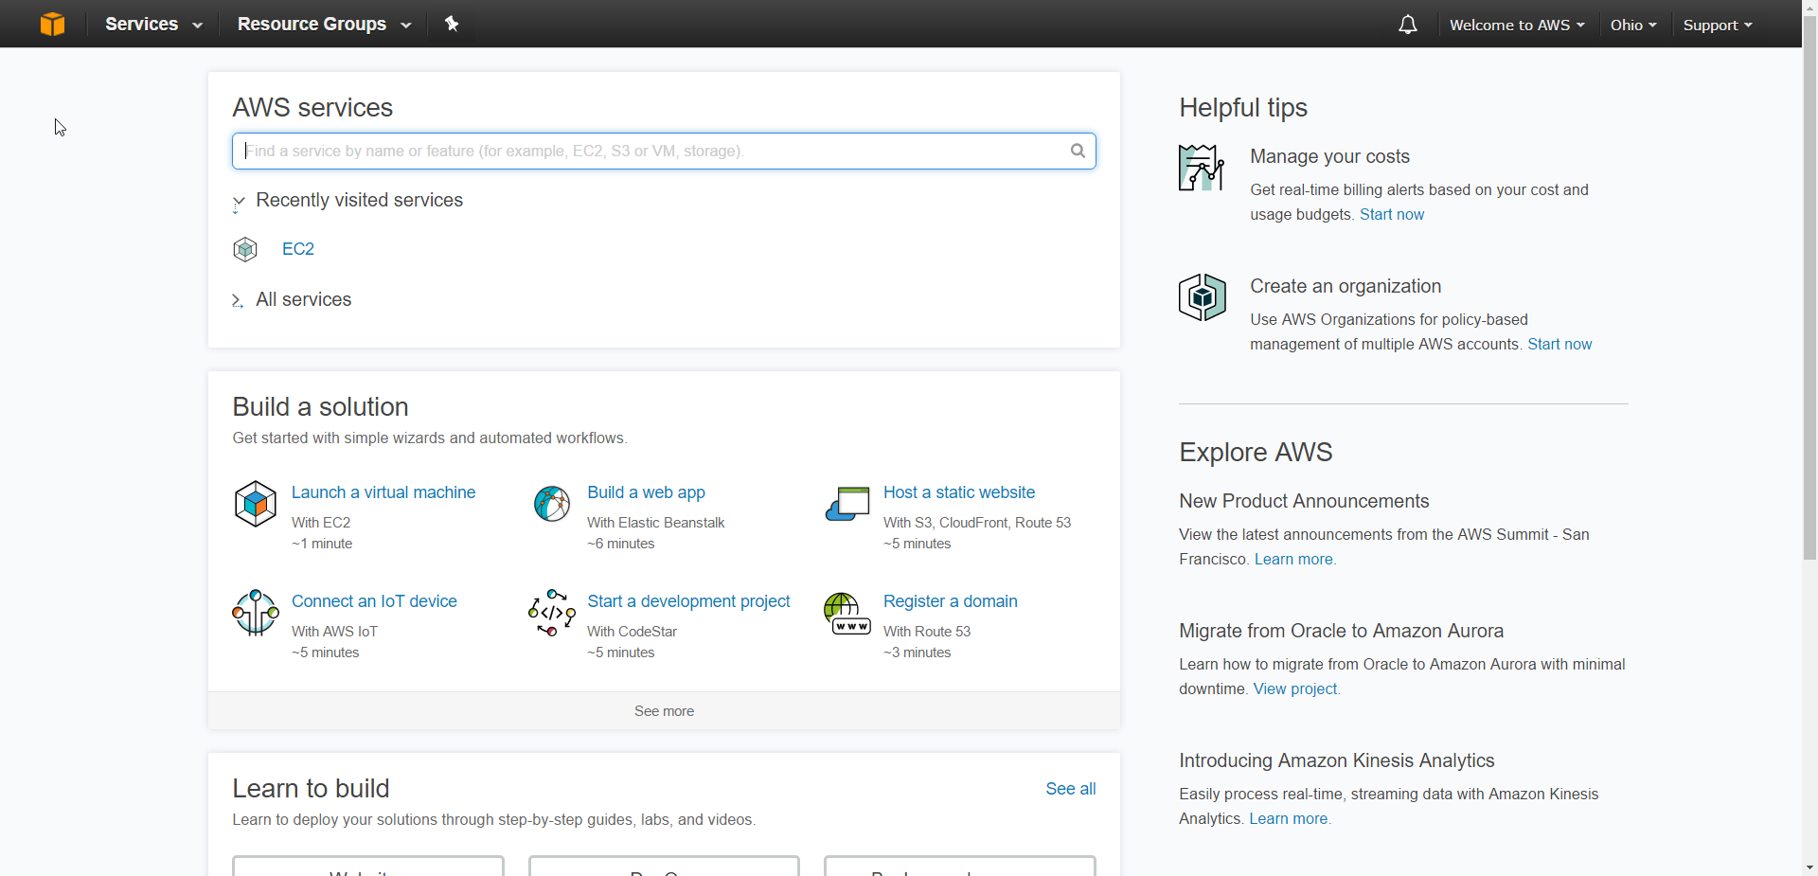
Console

Slide 5
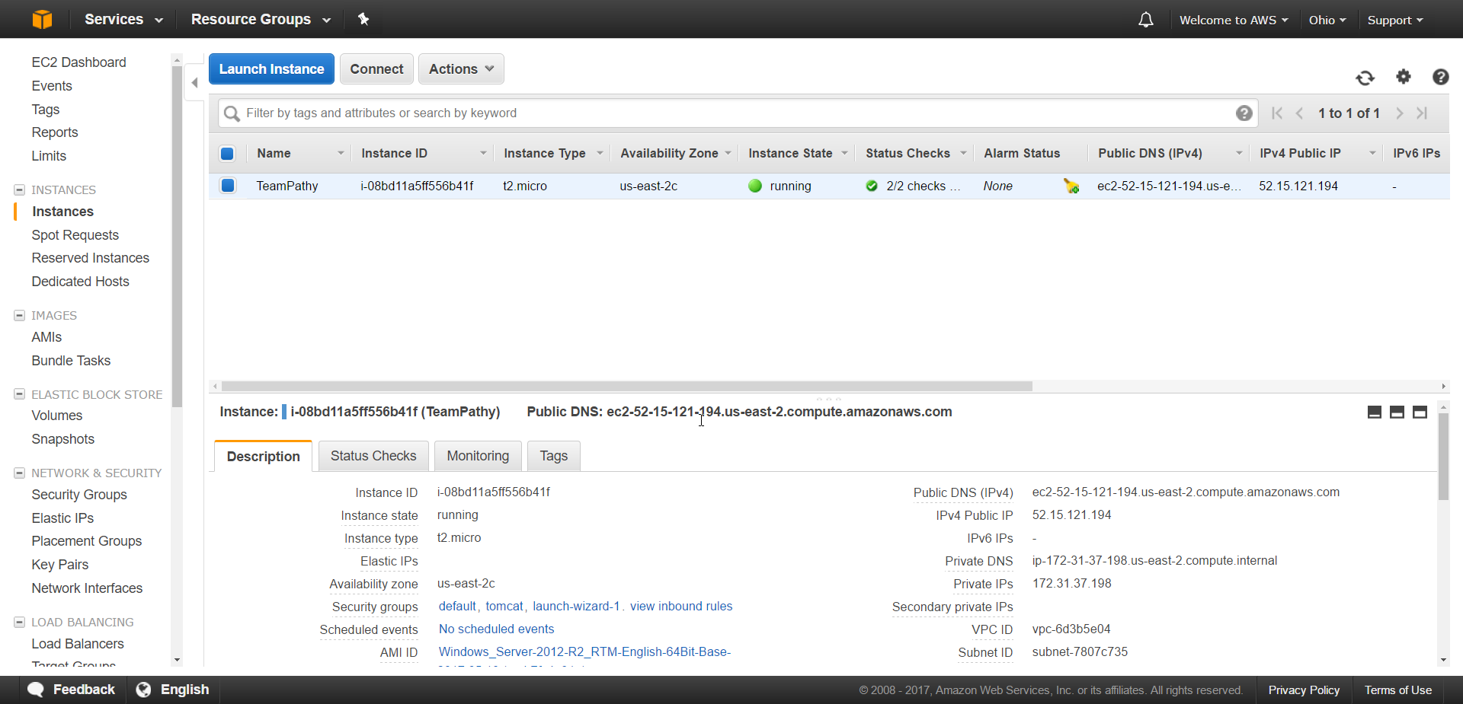
Instance
ec2-52-15-121-194.us-east-2.compute.amazonaws.com

Slide 6
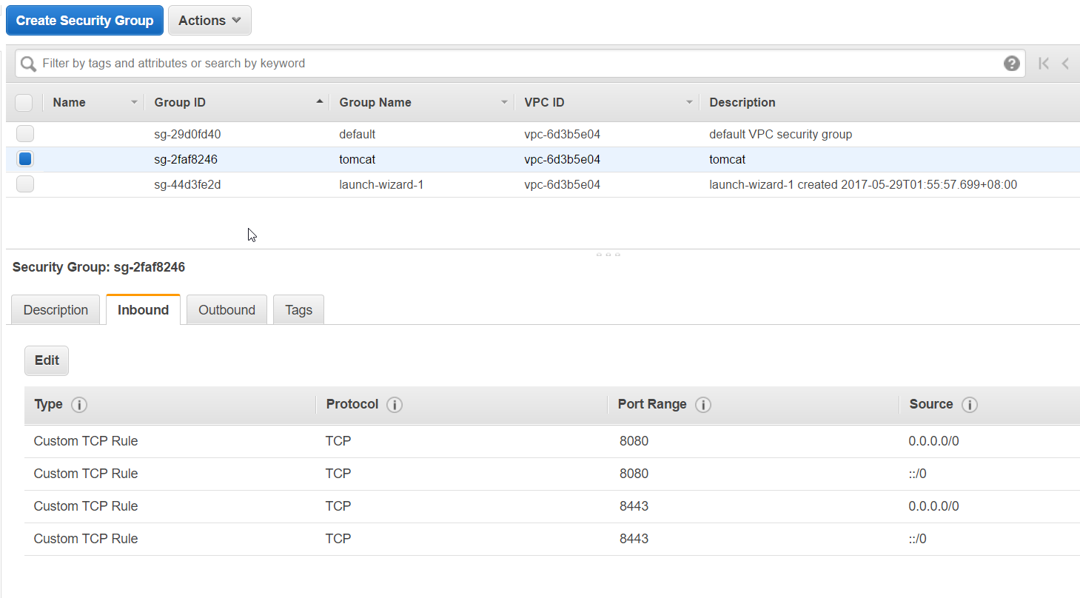
Security Group

Slide 7
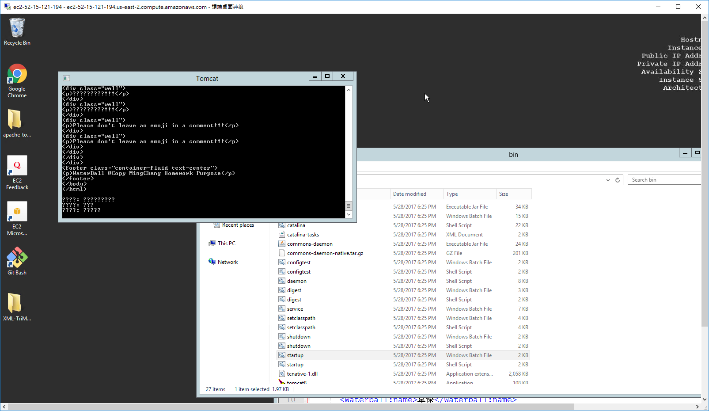
Virtual Machine

Slide 8

Domain Name Register
Dot.tk

Slide 9
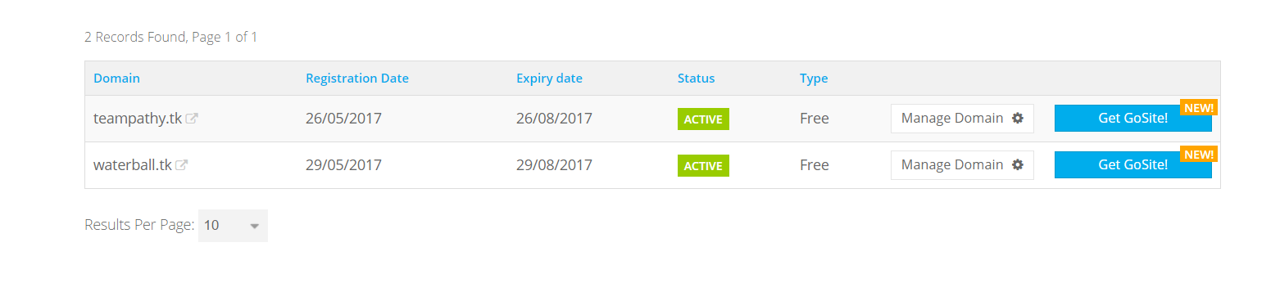
My Domains

Slide 10

Complete Tasks
WBS , Gantt chart API learning
Layouts
Discussed in the next page.
ER Diagram
Find A Server Instance
Preliminary document
Get A Logo

Slide 11
System | Name | UX
Member System | Sign In
 | Sign Up
 | Forgot Password
Project System | Project Grid List
 | Create A New Project
 | Searching Existing Project
DrawerLayout | Profile Page
 | TimeLine
TimeLine | TimeLine | Timeline Item Drop down animation
Forum | Forum Homepage | Transition Shared Animation
 | Post Details
TODO | TODO Homepage | Drag And Drop CRUD
 | Create A TODO
Office | Leader Functions | Open/Close Member List
 | Member List
 | Task Analysis
 |  | Member Online Status
 | Analysis Translation

Slide 12
Incomplete Tasks
Backend WebAPI (6/1~7/6)
Push Machanism (Firebase) (Dead)
Task Analysis XML (Dead)
IIS Server Setup
Final Document
Final Presentation

Slide 13


衝

